Slide 1
ethylene oligomerization: molecular strategies to avoid polyethylene fouling
Sibo Lin*, YagnaSENI Ghosh, DANA A. WONG, DOUGLAS THEBERGE, BRIAN HANNA
Aramco services company: Aramco Research Center -- Boston

Slide 2
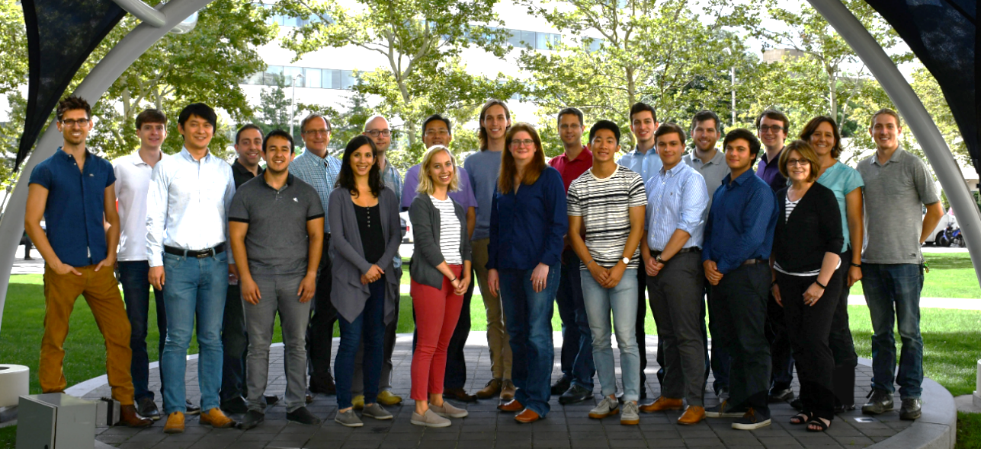
acknowledgements
Aramco Americas
Advanced Materials Team (Cambridge, MA)
Jenna C. Fromer
Yagnaseni Ghosh
Brian Hanna
Douglas Theberge
Dana A. Wong
Saudi Aramco Chemicals R&D
Mohamed Elanany
Wei Xu
Motaz Khawaji
King Fahd Univ. of Petroleum and Minerals
E. A. Jaseer
Samir Barman

Slide 3
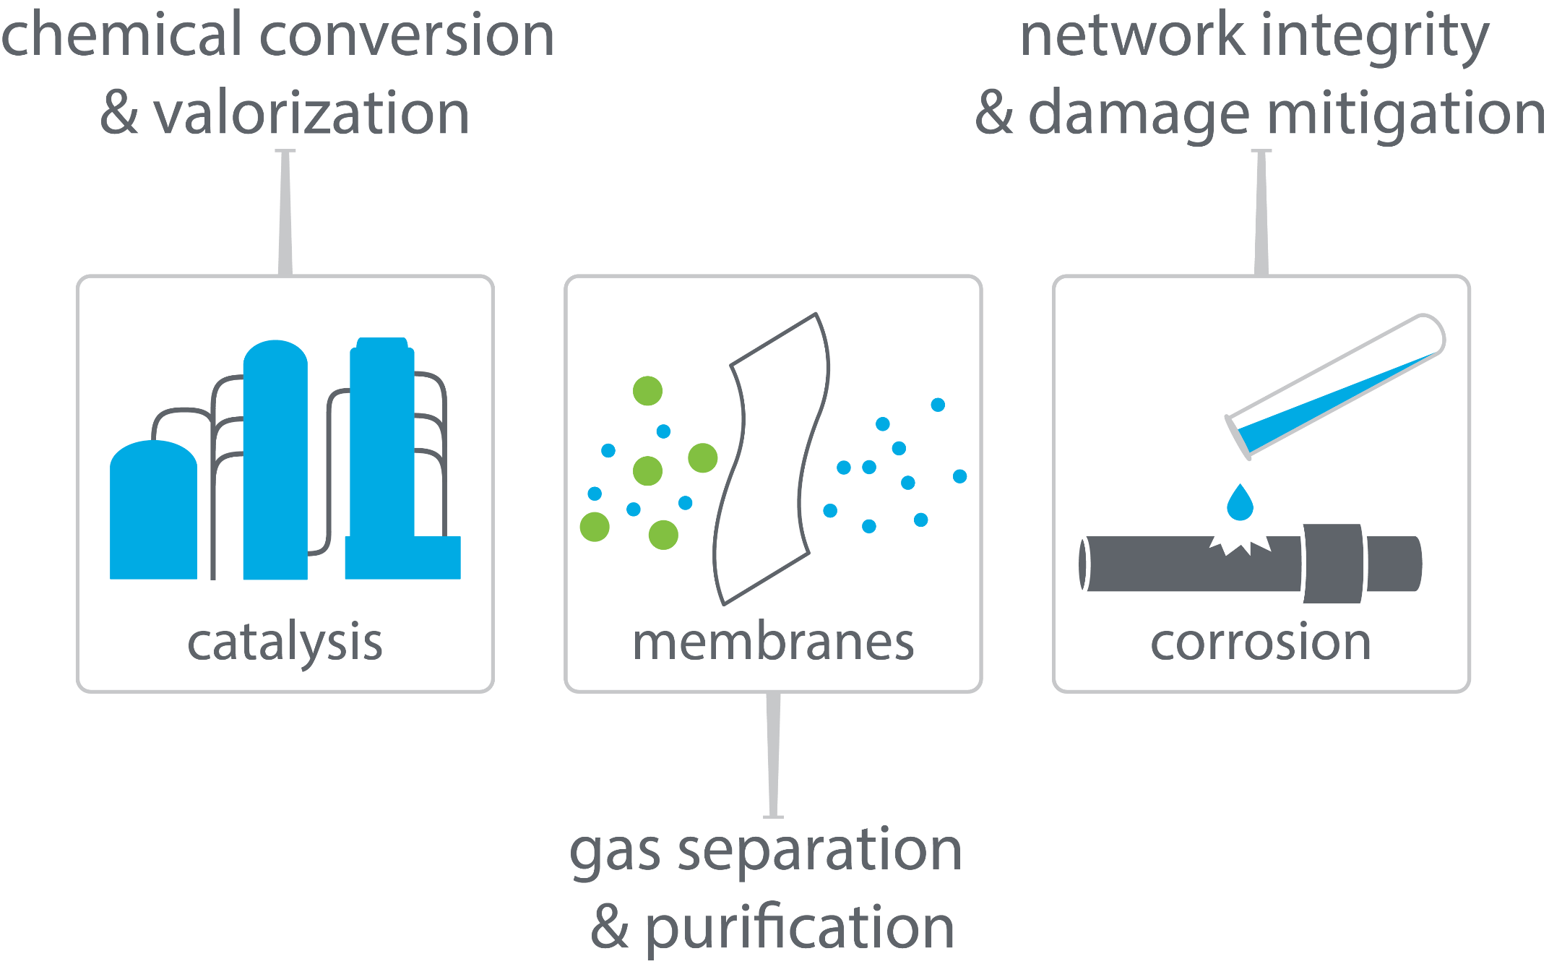
boston downstream research center

Slide 4
boston downstream research center

Slide 5

linear α-olefins for LLDPE
polyethylene plant
LLDPE
1-butene
ethylene
1-hexene
1-butene
1-hexene
polymer quality increases
1-octene
1-octene
highest quality plastic

Slide 6
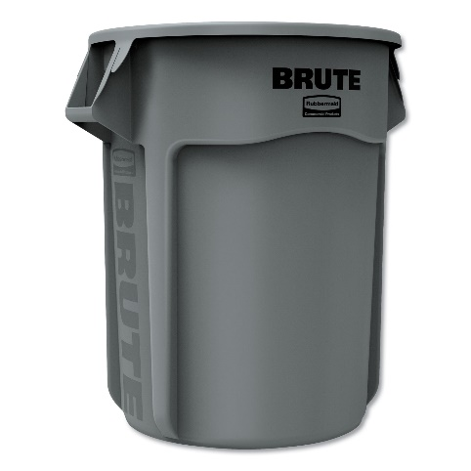
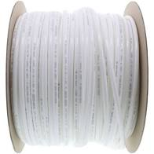
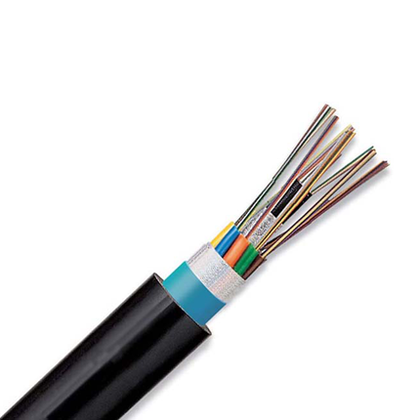
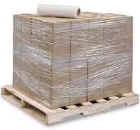
LLDPE
tough
flexible and food-safe
1-butene
stretchable
electrical and chemical safety
1-hexene
1-octene
Notes:
Image credits:
https://www.uline.com/Product/Detail/S-12827/Uline-Stretch-Wrap/Economy-Stretch-Wrap-Cast-80-gauge-18-x-1500
https://www.freshwatersystems.com/products/3-8-od-lldpe-polyethylene-tubing-500-ft-roll
https://www.hillnmarkes.com/
http://www.blspolymers.com/LLDPE.htm

Slide 7
full range α-olefins processes
How to make 1-octene selectively?
undesired products
1-butene
1-hexene
existing commercialized full range technologies:
Shell Higher Olefin Process (SHOP)
Chevron Phillips full-range process
INEOS process
1-octene
Nexant report - Developments in LAO Comonomer for Polyethylene - PERP 2012S11

Slide 8

two strategies for more 1-octene
confining full-range catalysts
selective ethylene tetramerization
modify a full-range catalyst to skew the product distribution
Nexant report - Developments in LAO Comonomer for Polyethylene - PERP 2012S11

Slide 9
selective ethylene tetramerization
Sasol’s catalyst
Activity (kg/g Cr/h) | 1-C₈ (wt%) | 1-C₆ (wt%) | PE (wt%)
272.4 | 67 | 12 | 1
Bollman et al, J. Am. Chem. Soc. 2004, 126, 14712
Confidential

Slide 10
ligand degradation may result in polyethylene
ligand | acid adduct¹ | activity² | C8 (wt%) | C6 (wt%) | PE (wt%)
 |  | 85 | 43 | 24 | 31
 |  | 1700 | 54 | 38 | 3
¹ Product with H[BAr^{F}₄]
² Catalytic activity (g/g Cr/h) with CrCl₃(THF)₃, 300 equiv. MMAO-3A, 60 psi C₂H₄
Agapie and coworkers, Organometallics, 2017, 36, 1640

Slide 11
hypotheses
computational modelling can predict PNP ligand stability
PNP instability is correlated with PE formation

Slide 12
computational prediction of isomerization thermochemistry (ΔG_{PPN})
2
2
3
2
3
2
3
wrong ΔG
how many conformers?
right ΔG
ca. 3³ x 2⁴ = 432
too many to rely on human intuition or employ brute-force high-level simulations

Slide 13
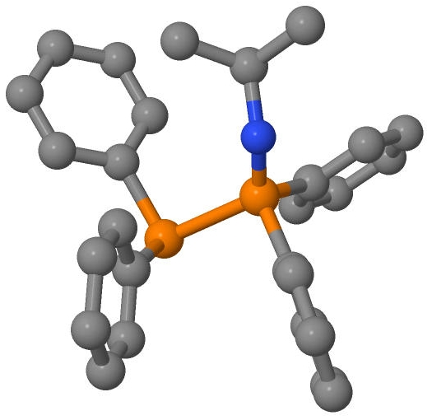
XTBDFT
conformer ensemble generation and ranking
(CREST and GFN-xTB)
ensemble refinement (NWChem)
minimum final optimization (NWChem)
quasi-harmonic frequency corrections
(Goodvibes)
62 conformers within 6 kcal/mol window
final structure and energy*
input geometry
(PES is only illustrative)
*calculated with B3LYP-D3/def2-TZVP//B3LYP-D3/def2-SVP and quasi-harmonic frequency corrections

Slide 14
ΔG_{PPN} vs known PNP/PPN ligands
ΔG_{PPN} > 0 (PNP favored)
ΔG_{PPN} < 0 (PPN favored)
If |ΔG_{PPN}| > 0.9 kcal/mol, prediction matches observations for 30+ known PNP/PPN

Slide 15
catalyst performance vs ΔG_{PPN}
✓
✓
make more stable (better) PNP catalysts
S. Kuhlmann, K. Blann, et al., J. Catal., 2007, 245, 279-284
K. Blann, A. Bollmann, et al., J. Catal., 2007, 249, 244-249.
E. Killian, K. Blann, et al., J. Mol. Catal. A: Chem., 2007, 270, 214-218.
Notes:
S. Kuhlmann, K. Blann, A. Bollmann, J. T. Dixon, E. Killian, M. C. Maumela, H. Maumela, D. H. Morgan, M. Prétorius, N. Taccardi and P. Wasserscheid, J. Catal., 2007, 245, 279-284.
K. Blann, A. Bollmann, H. de Bod, J. T. Dixon, E. Killian, P. Nongodlwana, M. C. Maumela, H. Maumela, A. E. McConnell, D. H. Morgan, M. J. Overett, M. Prétorius, et al., J. Catal., 2007, 249, 244-249.
E. Killian, K. Blann, A. Bollmann, J. T. Dixon, S. Kuhlmann, M. C. Maumela, H. Maumela, D. H. Morgan, P. Nongodlwana, M. J. Overett, M. Pretorius, K. Höfener, et al., J. Mol. Catal. A: Chem., 2007, 270, 214-218.

Slide 16
ligand candidates screened out (ΔG_{PPN} < 1 kcal/mol)
ΔG_{PPN} > 0 (PNP favored)
ΔG_{PPN} < 0 (PPN favored)

Slide 17
optimized PNP ligands compared with benchmark catalyst
ligand | Productivity | Product selectivity (wt%)
 | (kg g_{Cr}⁻¹ h⁻¹) | C₆ | 1-C₆ (in C₆) | C₈ | 1-C₈ (in C₈) | 1-C₆ + 1-C₈ | C₁₀₊ | PE
benchmark | 1184 | 22.8 | 81.6 | 72 | 97.1 | 88.5 | 1.6 | 3.5
ligand 1 | 1717 | 40.9 | 95.3 | 57.5 | 98.2 | 95.4 | 0.1 | 1.5
ligand 2 | 1492 | 24.1 | 56.1 | 72.5 | 95.2 | 82.5 | 2.6 | 0.8
ligands studied in collaboration with Samir Barman and E. A. Jaseer (KFUPM), manuscript in preparation

Slide 18
selective ethylene tetramerization summary
supported hypotheses
http://github.com/sibo/xtbdft
ruled out several candidates
developed novel PNP ligands
45% higher productivity
7.8% higher 1-C6 + 1-C8 wt%
57% lower PE wt%
Sci. Rep. 2021, 11, 4534

Slide 19
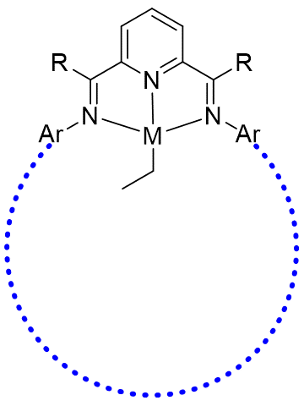
confining full-range catalysts
pyridyl diimine (PDI) catalysts
highly active
Schulz-Flory product distribution
troublesome polymer byproduct
confine full-range catalyst to cut off larger product distribution
Small, B. L. Acc. Chem. Res. 2015, 48, 2599
proposed confinement
chain-pore steric interactions hinder further chain growth

Slide 20


pore construction strategies
material | pore dimensions | pore size tunability | synthetic feasibility | synthetic tunability | reactant accessibility
zeolite
MOF
molecular
surface pores

Slide 21
surface pores shift product distributions
a
Conditions:
0.8 umol Cr or Fe
500:1 Al(MMAO-3A)/Cr
MeCy solvent
1h at 45 ºC
b
a
b
c
d
c
Prov. patent filed: “Surface supported catalysts with pore size control”
left-shifted Schulz-Flory distribution
lower polymer production
supported activity can be similar to homogeneous activity
d

Slide 22
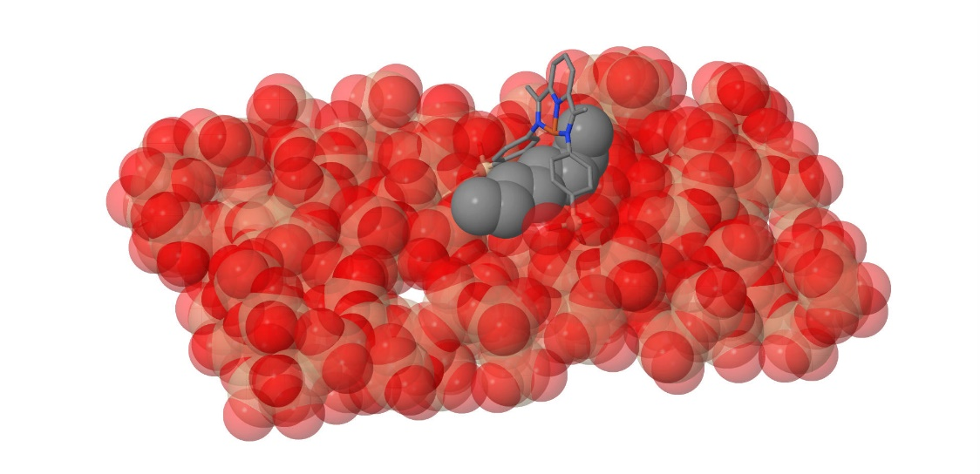
thank you

Slide 23
supplementary slides…

Slide 24
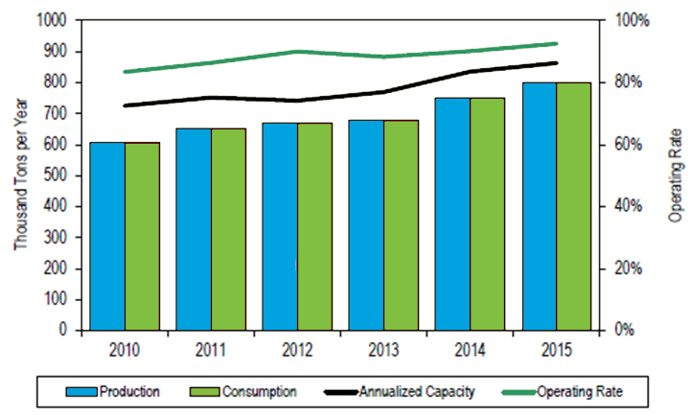
need for selective ethylene tetramerization
production capacity of 1-octene is not projected to keep pace with demand
1-butene
1-hexene
1-octene
Nexant report - Developments in LAO Comonomer for Polyethylene - PERP 2012S11
Confidential

Slide 25
design criteria to maximize PNP stability (and lower PE fouling)
electron-rich N-substituents
N-alkyl over N-aryl
R | ΔG_{PPN}
OMe | 4.7
H | 3.5
NO₂ | -0.9
ΔG_{PPN} | 3.5 | 9.0 | 0.5 | 8.9
N-alkyl: 2˚ > 1˚ >> 3˚
electron-poor P-substituents
R | ΔG_{PPN}
CH₂Ph | 8.6
CHMe₂ | 9.5
CMe₃ | 2.5
R | ΔG_{PPN}
CF₃ | 11.6
H | 9.5
OMe | -0.1
ΔG_{PPN} in kcal/mol

Slide 26
Inverse logarithmic relation
As a simplified model, if :
PNP and PPN isomers are in thermodynamic equilibrium ([PPN]₀/[PNP]₀ = e^{−ΔGPPN/RT})
initial PNP concentration is directly correlated with ethylene oligomerization productivity (oligomerization productivity = a[PNP]₀)
initial PPN concentration is directly correlated with polymerization productivity (polymerization productivity = b[PPN]₀)
a and b are constant across the range of PNP and PPN compounds
Then the following relation should be observed:
ln(polyethylene wt%)=ln(b/a)−ΔGPPN / RT
S. Kuhlmann, K. Blann, et al., J. Catal., 2007, 245, 279-284
K. Blann, A. Bollmann, et al., J. Catal., 2007, 249, 244-249.
E. Killian, K. Blann, et al., J. Mol. Catal. A: Chem., 2007, 270, 214-218.

Slide 27
making 1-octene selectively from ethylene
Sasol’s catalyst
Activity (kg/g Cr/h) | 1-C₈ (wt%) | 1-C₆ (wt%) | PE (wt%)
272.4 | 67 | 12 | 1
Bollman et al, J. Am. Chem. Soc. 2004, 126, 14712
Confidential

Slide 28
1-octene results from metallocycle mechanism
Metallocycle formation
Ring growth
Ring termination (β-hydride transfer)

Slide 29
GFN-xTB/CREST vs molecular mechanics (MM)
Computational intensity: MM < GFN-xTB << DFT
MM methods must be carefully parameterized for molecules of interest
Commonly available MM methods (MMFF and UFF) perform poorly with metal centers or exotic functional groups
GFN-xTB is generally applicable to many elements (H-Rn) and types of molecules[ref]
CREST uses meta-dynamics to explore wide conformer space
CREST also eliminates symmetrically equivalent conformers (by comparing energy and symmetry)

Slide 30
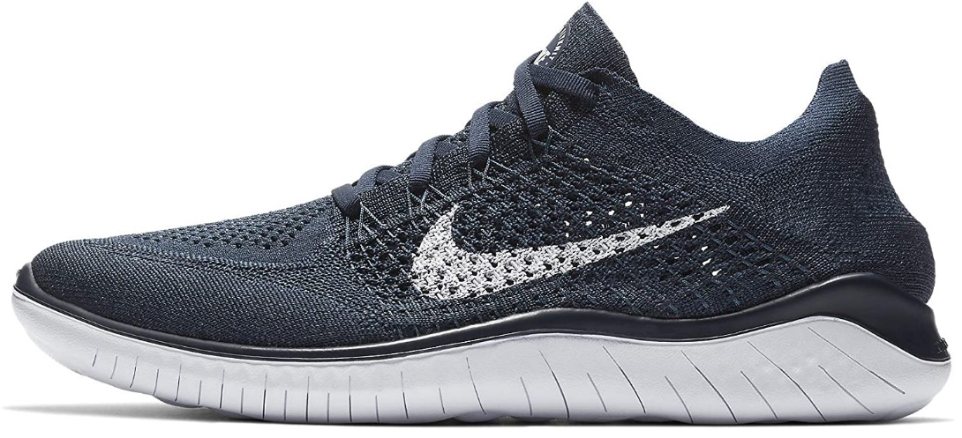
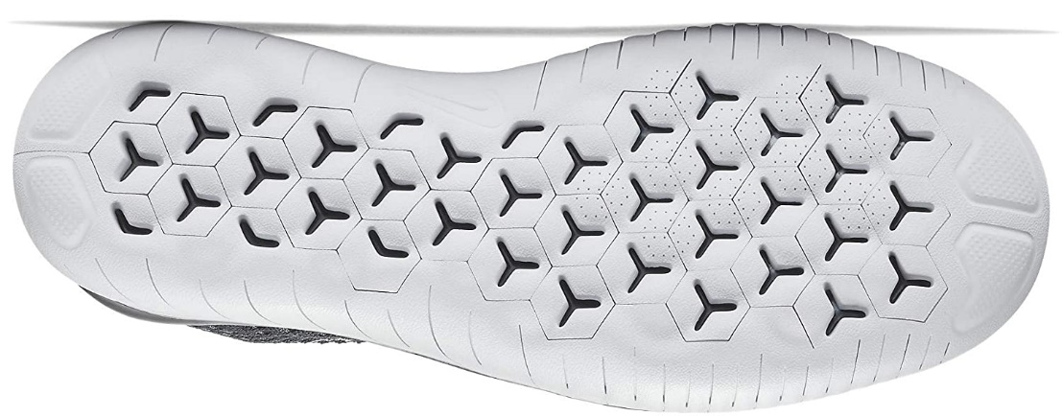
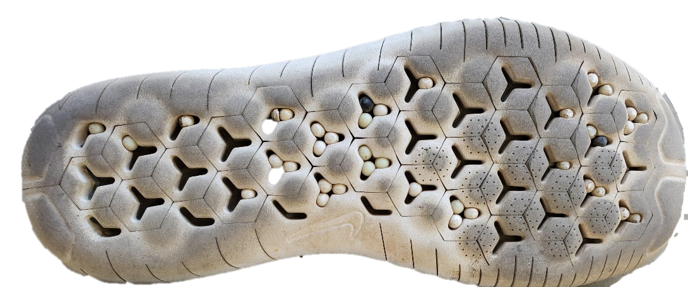
criteria for choosing running shoes
lightweight
soft yet bouncy
flexible yet stable
affordable
…easy to clean

Slide 31
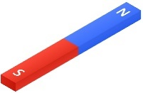
need well-designed catalysts to avoid polymerization
polymerization catalyst
tetramerization catalyst

